Slide 1
ICAOS Annual
Business Meeting
Opioid Initiative Panel
OCTOBER 8, 2019
Notes:
Opening slide for RJOI introduction
RJOI is next 4 slides

Slide 2
ICAOS Annual Business Meeting
Opioid Initiative Panel
Judge Jennifer Bailey
Judge Jon Cleary
West Virginia
Indiana
Judge Duane Slone
Donna Strugar-Fritsch
Tennessee
RJOI Chairman
BSN, MPA, CCHP
Health Management Associates
Moderated by Commissioner Russ Marlan, Michigan
Notes:
Moderator will introduce each panelist and allow each panelist to give a brief intro on his/her role on initiatives to address opioid epidemic.

Slide 3
Today’s Objectives
Share information on:
    Judicial Initiatives
      Regional Judicial Opioid Task Force
      National Judicial Opioid Initiative
    Evidence-Based Interventions
      Opioid Intervention Courts
      Jail and Medication Assisted Treatment (MAT)
      Expand Access to MAT (CA)
    ICAOS Considerations

Slide 4
Regional Judicial Opioid Initiative
Components
  Judicially-led effort
  Multistate
  Champions – Chief Justice of Supreme Court (and State Court Administrators)
  Recognition of effects (complexity/fatality) on:
      Criminal dockets
      Family Court dockets
  Courts are an active part of the solutions
  Responses should be driven by data (when available)

Slide 5
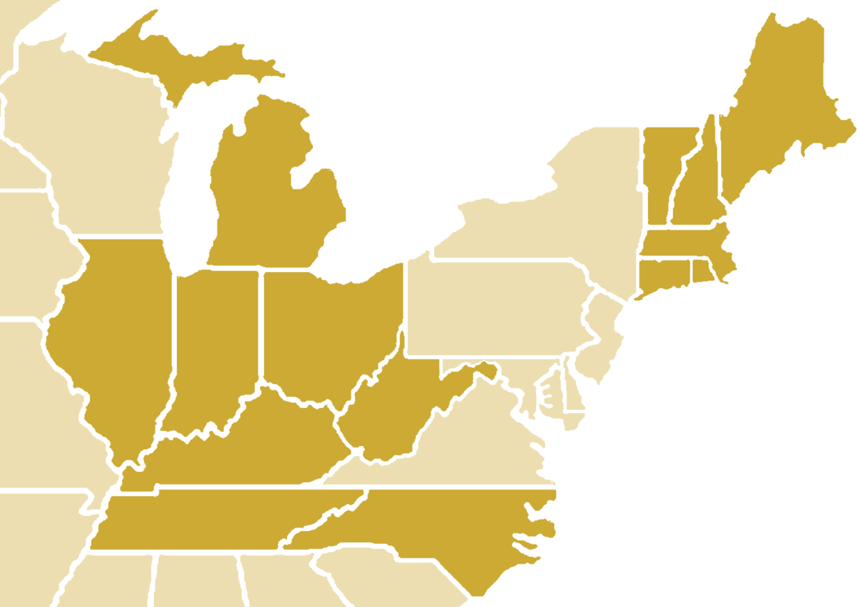
Regional Judicial Opioid Initiatives
Appalachian/Midwestern (2017)
Illinois
Indiana
Kentucky
Michigan
North Carolina
Ohio
Tennessee
West Virginia
New England (2019)
Connecticut
Massachusetts
Maine
New Hampshire
Rhode Island
Vermont
Attention on areas around state boundary lines (access to treatment or services, data sharing, hot spots)

Slide 6
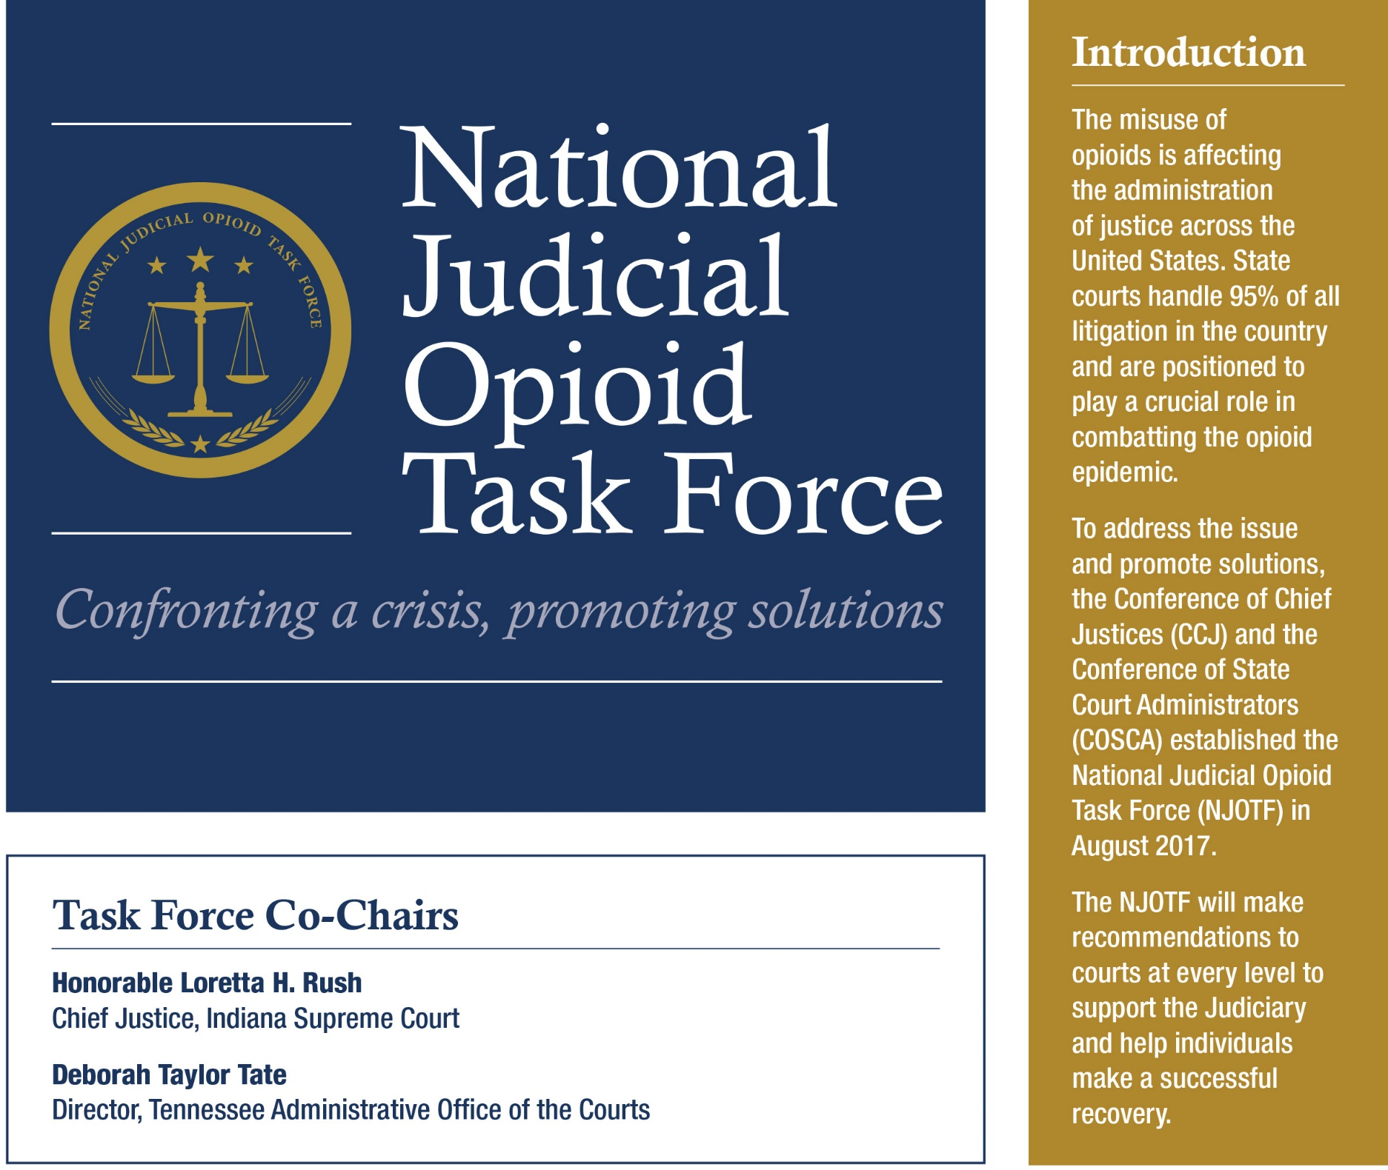
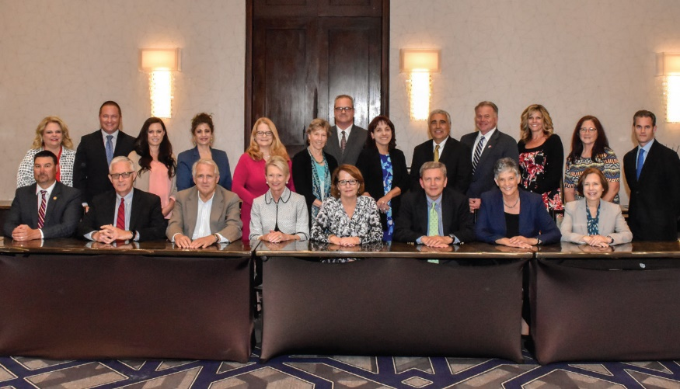
Task Force Members
Members of the National Judicial Opioid Task Force convened in Indianapolis in June 2018. The Task Force includes representatives from 24 states, most of whom are pictured above.
Notes:
Opening slide for NJOTF
NJOTF is the following 2 slides

Slide 7

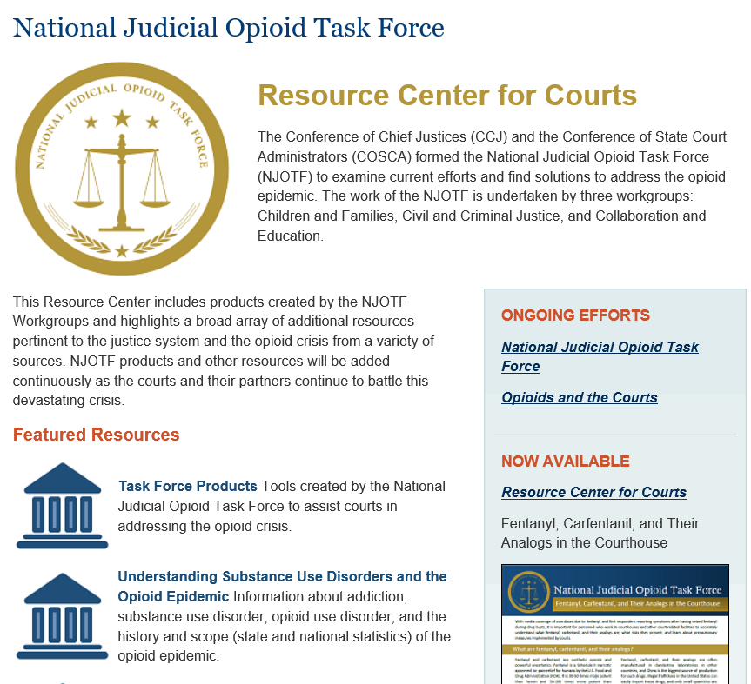
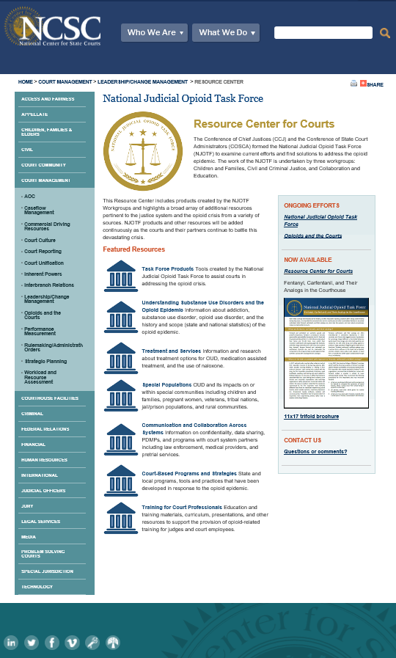
Opioid Resource Center for Courts
www.ncsc.org/opioids

Slide 8
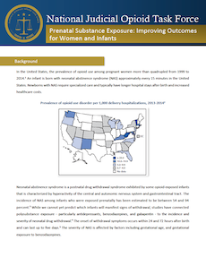
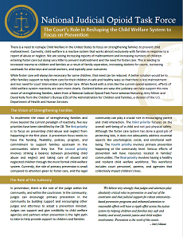
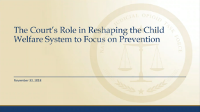
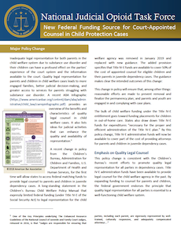
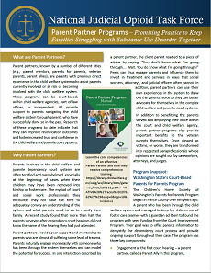
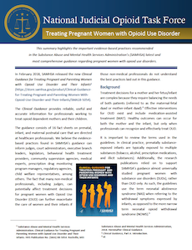
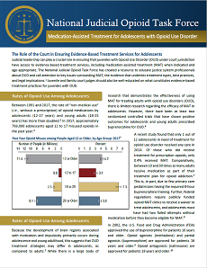
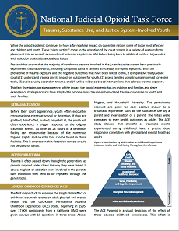
Children and Families
NJOTF Tools and Resources for Courts
Prenatal Substance Exposure: Improving Outcomes for Women and Infants Information and guidance regarding how courts can help to improve outcomes for substance exposed infants and their families.
The Court’s Role in Reshaping the Child Welfare System to Focus on Prevention Takeaways from a National Judicial Opioid Task Force webinar featuring Jerry Milner and David Kelly from the Children’s Bureau of the Administration for Children and Families.
New Federal Funding Source for Court-Appointed Counsel in Child Protection Cases Discusses how the new policy for Title IV-E funds promotes quality legal representation for parents and children in child welfare dependency cases.
Parent Partner Programs – Promising Practice to Keep Families Struggling with Substance Use Disorder Together Discusses how some states are using parent partner programs to improve reunification outcomes and foster increased trust and confidence in the child welfare and juvenile court systems.
Treating Pregnant Women with Opioid Use Disorder Highlights the important evidence-based practices recommended in the Substance Abuse and Mental Health Services Administration’s (SAMHSA) latest and most comprehensive guidance regarding pregnant women with opioid use disorders.
Medication-Assisted Treatment for Adolescents with Opioid Use Disorder Resource to educate justice system professionals about opioid use disorder, key issues surrounding medication-assisted treatment, the evidence that underlies treatment types, best practices, and legal implications.
Trauma, Substance Use, and Justice System Involved Children Raises awareness of the impact the opioid epidemic has on children and families and shares examples of strategies courts have adopted to become more trauma-informed and trauma-responsive to youth and their families.
www.ncsc.org/opioids

Slide 9

Survey of
ICAOS Stakeholders

Slide 10
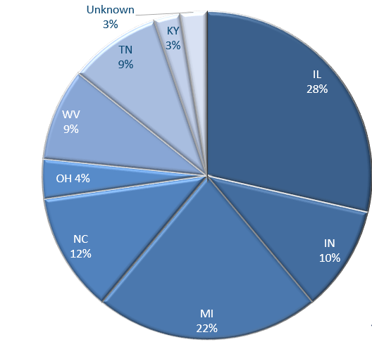
RJOI / ICAOS Survey
77 Respondents
Survey focused on judges at the border of the state and a felony criminal docket.
Notes:
77 Respondents
Illinois sent to all judges so may be over represented in the sample and increased the responses of those rarely effected by ICAOS.

Slide 11
RJOI / ICAOS Survey
Information Needed
What areas do you need more information to do your job well (training) in relation to ICAOS?
Rules of ICAOS (judges, attorneys, problem- solving court coordinators.
Protocols, criteria, forms, and resource guide
Referral and transfer process
Session on advanced issues
Interdisciplinary communication between courts and treatment facilities/professionals
General training on ICAOS at judicial conference
Resources (list of accredited facilities)
Define quality treatment
Increased exposure to best practices
Security of treatment facilities at out-of-state and effectiveness of treatment
Updated rules, amendments and advisory opinions on transfer request time periods and criteria
Outcomes of transfer
Diversion programs

Slide 12
Evidence-Based Interventions

Slide 13
Opioid Intervention Courts
Broad legal eligibility
Immediate screening for risk of overdose
Informed consent after consultation with defense counsel
Suspension of prosecution or expedited plea
Rapid clinical assessment and treatment engagement
Recovery support services
Frequent judicial supervision and compliance monitoring
Intensive case management
Program completion and continuing care
Performance evaluation and program improvement
Source: The 10 Essential Elements of Opioid Intervention Courts
https://www.courtinnovation.org/sites/default/files/media/documents/2019-07/report_the10essentialelements_07092019.pdf
Notes:
Published July 2019
“The 10 Essential Elements of Opioid Interventions Courts”

Slide 14



The Landscape of Addiction Treatment Services for the Justice-Involved
Presented to Interstate Commission on Adult Offender Supervision
October 8, 2019
Notes:
Donna’s presentation starts here.

Slide 15
ABOUT HMA
35-year history of national consulting focused on publicly-sponsored health care
  Focus on low income, uninsured, vulnerable populations
  23 offices in 19 states
  Extensive work with behavioral health, Medicaid
16-year history of consulting in correctional health – prison systems and jails across the US
Expert in all aspects of correction health design, operation, financing, and oversight; nationally recognized
Extensive work in opioid addiction
Notes:
Use this slide as your Default Slide/New Slide.
To Create a new Slide use DUPLICATE SLIDE option.

Slide 16
ABOUT HMA
Opioid work:
  Clinical – writing clinical guidelines and toolkits, training primary care providers
  Community – building seamless transitions of care for persons using MAT
  Criminal Justice
    Teams from 29 counties in CA expanding access to MAT in jails and drug courts. Exceptional and rapid progress in all counties.
    Teams from 16 counties nationally, mirrored on CA work and funded by Arnold Ventures and Bureau of Justice Assistance.
    Statewide training program in CA to train adult and youth/dependency courts, DAs, public defenders, probation, child welfare workers on neuroscience of addiction and treatment of opioid addiction with MAT.
Notes:
Use this slide as your Default Slide/New Slide.
To Create a new Slide use DUPLICATE SLIDE option.

Slide 17
STANDARD OF CARE FOR OPIOID USE DISORDER (oud)
All three forms of MAT available to patient under individualized treatment plan developed by provider and patient
OUD is a protected condition under the Americans With Disabilities Act
Access to MAT is expected
Behavioral Therapies are essential to success – MAT is not enough

Slide 18
Alignment in justice system
Access to and acceptance of all three forms of MAT varies widely and for many reasons.
Justice system often involved in “ordering” and terminating MAT
In lawsuits based on ADA protections for access to MAT, the patients are always winning
Evidence-based Behavioral Therapies must include those pertinent to justice system and focused on criminogenic issues

Slide 19

THE SHIFTING LANDSCAPE OF SUBSTANCE USE TREATMENT
ALCOHOL AND DRUG (AOD) SERVICE LANDSCAPE PRIOR TO ABOUT 2005…
Mish-mash of private and public providers with little research or evidence-based care; heavy focus on abstinence
Methadone legal for treatment of OUD since 1970; only in strictly regulated NTPs/OTPs; little convergence with abstinence-based care
Little insurance or Medicaid coverage for SUD treatment
Lots of fraud in the industry, and little accountability for outcomes measurement or reporting
Many state and county justice systems developed relationships with providers that served offenders exclusively
Institute of Medicine publishes Crossing the Quality Chasm: A New Health System for the 21st Century in 2001 calling for fundamental changes in all health service delivery and focuses on coordinated care and AOD delivery system. Most state alcohol and drug programs have minimal services, have insufficient provider networks, and few standards for this type of care.”
Notes:
1 in 10 individuals in need of treatment access treatment

Slide 20
THE SHIFTING LANSCAPE OF SUBSTANCE USE TREATMENT
Around 2000, momentum develops for “parity” in insurance coverage of medical and behavioral health benefits (BH = MH + SUD)
Paul Wellstone and Pete Domenici Mental Health Parity and Addiction Equity Act of 2008 (MHPAEA): federal law that generally prevents group health plans and health insurance issuers that provide mental health or substance use disorder (MH/SUD) benefits from imposing less favorable benefit limitations on those benefits than on medical/surgical benefits (private insurance). Started move toward evidence-based care, assessments using specific criteria, etc.
Medicaid had essentially no SUD benefits for persons with primary SUD, though if there was a primary MH condition with secondary SUD, the SUD could be addressed in the context of MH care
2014 Affordable Care Act: States that opted in required to provide robust SUD benefit
  Millions of low-income adults gained access to SUD treatment
  Increased move toward for evidence-based care, outcomes reporting
2016 CMS allowed states to apply MHPEA rules to Medicaid Managed Care Organizations
So now, many states have robust Medicaid benefits for SUD treatment and all private insurance is subject to parity requirements
Many justice systems have not changed their contractors or approaches during this transition.
Notes:
Use this slide as your Default Slide/New Slide.
To Create a new Slide use DUPLICATE SLIDE option.

Slide 21
Enter the opioid epidemic…..
American Society for Addiction Medicine (ASAM) developed evidence-based criteria for assessment and levels of care
Movement away from traditional 90-day programs, etc.
Most states basing public programs on ASAM
Medication Assisted Treatment becomes standard of care for OUD, but lots of posturing about which form is best, especially in the justice system
Huge challenges getting treatment providers to move off of abstinence- based approach

Slide 22
CURRENT STATE
Only a few states have required that Medicaid only contract with providers that “accept” MAT, and transition is not complete in the states that have.
Lots of providers are not accepting patients on MAT, especially residential programs
Growing wait lists and access problems for programs that accept and incorporate MAT, so not surprising that the ISC is experience problems
Venture capitalists looking at opportunity to cash in on treatment – creates opportunity for “shady” programs that pop up fast
Confusion around providers serving justice system
Notes:
Use this slide as your Default Slide/New Slide.
To Create a new Slide use DUPLICATE SLIDE option.

Slide 23
SCALE OF THE PROBLEM
Two-thirds of people in jail meet the criteria for drug dependence or abuse. —Bureau of Justice Statistics 2014
Of these, at least 25% have an OUD.
So at least 16-17% jail detainees have OUD
Many more have alcohol, methamphetamine addictions
Risk of overdose increases 129 times over the general population for those who go cold turkey, leave jail, and return to their previous levels of drug use.

Slide 24
REMEDIES FOR COURTS
Engage your county AOD program as a partner – your clients are their clients, and your population is a priority population to the county
Get help from them in understanding the local treatment network
Don’t expect your clients or DAs or PDs to understand any of this (but they can be taught!)
County AOD program can help you:
  Move to providers that can bill Medicaid (90% federal match in expansion states)
  Find in-state providers
  Find out-of-state providers
    Medicaid coverage for treatment in another state might be a tough climb
  Check out new providers for program integrity
Note: All county AOD programs come under auspices of county manager and most are under public health officer – these people will want to work with you on behalf of your shared clients

Slide 25
Donna Strugar-Fritsch
Principal
Health Management Associates dstrugarfritsch@healthmanagement.com
415-489-2027

Slide 26

ICAOS Considerations

Slide 27
ICAOS Considerations
  Border Court Education/Awareness
  Access to resources and/or Compact specialist
  Legitimacy of Treatment Centers
  Verification resources
  Justification for treatment as part of plan of supervision
  Extension of short term treatment triggering the Compact
  Expediting process or procedures at local level
  Compact Office assistance
Notes:
How can judges be more educated on compact processes when requiring treatments as a condition of supervision?
Ensuring treatment centers are legitimate
How can courts assist in providing good justifications for transfers?
What can compact do to better verify treatment centers when investigating transfers?
Border issues
How can Compact be more aware of border treatment opportunities for offenders?
How can courts in border areas be more aware of the compact?
When short term treatment may be extended triggering the compact
How can Compact be more aware of such cases?
How can courts ensure ALL treatment cases are brought to the attention of ISC?

Slide 28
Open Discussion
Judge Jennifer Bailey
Judge Jon Cleary
West Virginia
Indiana
Judge Duane Slone
Donna Strugar-Fritsch
Tennessee
RJOI Chairman
BSN, MPA, CCHP
Health Management Associates
Moderated by Commissioner Russ Marlan, Michigan

