Slide 1
Evidence Based Practices: What gets in the Way and some Ideas to Help Systems Move Forward
Presented by:
Edward J. Latessa, Ph.D.
School of Criminal Justice
University of Cincinnati
www.uc.edu/criminaljustice
Edward.Latessa@uc.edu

Slide 2
Organizational Development and Some Ideas to Think About
Implementation Issues – what gets in the way and some models to consider
Example from Ohio of how to develop a network of experts
Using data to improve performance

Slide 3
Implementing What Works
30+ years have provided insight into “what works” – strongest model is Risk, Need, Responsivity model
Despite mounting research that we can reduce recidivism through correctional programming and good supervision practices there remains minimal information as to “how” it can work - technology transfer
Notes:
So based on this interest, my proposal looks at, what has been accomplished, research-wise, in the field of corrections (EBPs) and ways in which these practices can be best sustained.
Research over the years has identified the “what works” in community supervision, though little attention is given as to “how” these strategies can be best translated into real-life settings, on a larger scale.
With correctional costs continuing to increase, it is important to understand how these strategies can be most effective and efficient with regard to correctional services, even after training has been provided to staff. Within the realm of community supervision, agencies across the country are attempting to implement evidence-based supervision practices. Research on these practices demonstrate its ability to reduce offender recidivism while providing offenders with “tools” to manage and cope with risky situations in addition to holding them accountable.
The training may be ideal, but the issue comes about when staff and agencies are to take what they have learned and use it in practice, or “real world” settings. Once the training is over, it is generally up to the staff within the agency to determine how to implement and maintain what is learned in trainings. Additionally, a survey in the field of human services out of the Institute of Medicine (2001) found that “human services typically are inconsistent, often ineffective, and sometimes harmful to consumers” (Fixsen, Blasé, Naoom, & Wallace, 2009, p. 531).

Slide 4
Current Research on Implementation
Mostly anecdotal, case studies or personal experience - very minimal empirical research
More focused on substance-abuse treatment programs, less so on community corrections
Key findings
More likely to facilitate organizational change for EBPs in performance-oriented, open learning environments (Friedmann et al, 2007)
Only 10% of what is learned in training is retained—support for ongoing coaching, consultation and feedback
Notes:
Will add more to this in the dissertation, not currently in my proposal to the extent of compilation of research in this capacity
Discuss how this fits into NIRN’s framework, but particular to community corrections settings.
Lead-in: Because little has been done, it is important to look at other research and resources that provide some insight into implementation and sustainability. NIRN’s framework provides that in the context of human services

Slide 5
What Gets in the Way?
Organizational culture
Lack of leadership
Ineffective or resistant supervisors
Lack of staff input on program changes
Poor communication
Staff changes/staffing patterns
Union Issues
Staff Attitudes
Freeing up staff time
Administrative support
Curricula delivery
Security Issues
Lack of collaboration
Political will

Slide 6
Suggestions for developing effective programs
Need to find leaders to serve as champions
Different levels are important
Supervisors are the key to successful implementation
Need additional training and need to part of the process
All staff need to be trained, but training alone isn’t enough
Need to provide on-going coaching and support as well as booster sessions

Slide 7
Overcoming barriers
Need to build capacity to sustain change
Develop cross organizational teams
Train cadre of trainers and coaches
Need to distinguish between activities & core correctional programming
Helps focus on criminogenic targets for change
Reduces program drift
Treatment needs need to be manualized
Provides structure and easier to replicate
Improves quality assurance
Improves consistency

Slide 8
Overcoming Barriers
Data makes a difference
Evaluate and collect data and make changes as needed
Changing is Difficult
Take it one program at a time

Slide 9
There are some Frameworks for Implementing EBP

Slide 10
Six Functional Stages of Implementation (Fixen, et al (2009)
Exploration
Installation
Initial implementation
Full implementation
Innovation
Sustainability
Notes:
Implementation of evidence-based practices or models is a process that can take several years. Fixsen and colleagues (2009) identify six functional stages of implementation to help with incorporation of the intervention model components: exploration, installation, initial implementation, full implementation, innovation, and sustainability. Stages impact each other in complex manners and the stages are not necessarily linear. Each stage has a specific purpose in order to help increase success in implementation and future sustainability. Table 1 provides a brief overview of the functional stages of implementation.
Table 1. Overview of the Functional Stages of Implementation
__________________________________________________________________________________
Exploration Stage
Acquisition of research and knowledge of program/practice options; staff and agency preparation and assembly of resources
Installation Stage
Building capacity within the organization to begin program piloting, or implementation. Requires acquisition of funding, human resources, policies, reporting system framework, and outlining of expected outcomes
Initial Implementation Stage
Incorporation of new changes for individuals and organization for beginning implementation. Uses data to make adjustments and helps to identify benchmarks
Full Implementation Stage
Full capacity integration of initial implementation program/practice, with adjustments. Also incorporates innovation—making modifications, expansions, and refining of practices—all data driven
Sustainability Stage
Maintaining the practice/program with fidelity in subsequent years; making sure there is continuation of funding, staff training, resources, and support.

Slide 11
NIRN Implementation Components Competency & Organization Drivers
Notes:
Within the implementation framework (or stages) are implementation drivers. Implementation drivers assist organizations in their capacity to create “practice, program, and systems level changes needed to achieve improved population outcomes” (Bertram et al., 2013, p. 12). These are categorized into three types of drivers that work together to help the success of the stages of implementation and sustainability (Bertram et al., 2013). The three categories of drivers are competency drivers, organization drivers, and leadership drivers. Each of these drivers should be incorporated into the implementation framework identified above and are part of the organizational and individual level aspects of implementation and sustainability. These three categories of drivers work together in a compensatory and integrated fashion to increase fidelity (performance assessment), influencing consistent program implementation, and thus, improved outcomes (Fixsen, et al., 2009; Fixsen et al., 2005). Table 2 and provides a brief overview of implementation drivers.
Competency Drivers
Researchers identified competency drivers through review of the commonalities among successful implementation programs (Fixsen et al., 2009; Fixsen et al., 2005; Bertram et al., 2013). Competency drivers include staff selection, training, ongoing coaching and consultation, and staff performance assessment. These competency drivers are also vital to promoting competence and comfortability in implementing the program model. This helps increase fidelity to the program model and improved outcomes through implementation and sustainability (Bertram et al., 2013; Fixsen et al., 2009). As a whole, when analyzing these competency drivers, an organization can assess, recognize, and better rectify any administrative issues or concerns in addition to system level concerns that may affect model fidelity or targeted outcomes (Bertram et al., 2013).
Staff selection
Identification of individual(s) qualified to execute the evidence-based practice—trainers, coaches, line staff, evaluators, and administrators.
Includes education, experience, field knowledge, professional skills, common sense, sense of social justice, ethics, desire to learn and intervene, empathy, and appropriate judgment.
Training
Consists of pre-service and in-service training, transferring knowledge in applying evidence-based practice to daily activities.
Introduces philosophy, values, scientific background, components, rationale, key practices, and opportunity for practice and feedback.
Ongoing Coaching & Consultation
Providing ongoing support and learning in using new concepts in daily activities.
Includes practice of skills, feedback, and support to increase competency and confidence in using concepts.
Staff Performance Assessment
Assessment of use, fidelity, and outcomes of concepts taught during training and ongoing coaching.
Helps support effective, sustainable implementation by assessing program/practice fidelity; not purely for job retention and promotion.
Organization Drivers
Organization drivers consist of decision support data systems, facilitative administrative supports, and system interventions (Fixsen et al., 2005; Bertram et al., 2013). It is important to consider organization drivers during the exploration stage in order to best identify organization and system readiness for change.
Decision Support Data Systems
Identification of key aspects to assess overall performance of the organization with regard to newly adopted evidence-based practice.
Includes measures of organizational fidelity, consumer outcomes, and quality improvement information. This helps assist policy and practice for continued improvement and success.
Facilitative Administrative Supports
Attention is placed on organization’s policies, protocols, structures, culture, and climate for adjustments to these facets with staff needs.
Important for administration to consider what is needed in order to produce desired outcomes; uses feedback loops.
System Interventions
Attention to the continually changing context of federal, state, organizational, and community-level factors and how socio-economic, political, and cultural concerns influence these changing contexts and environments.
Facilitative administration helps analyze system level factors to help with outcomes.

Slide 12
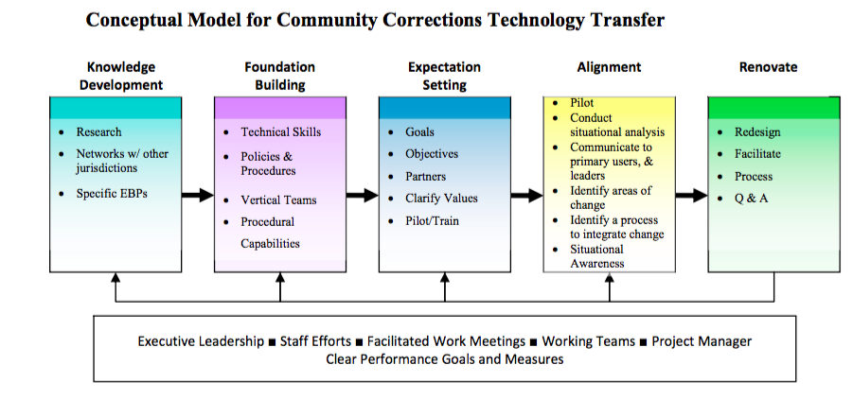
Community Corrections Technology Transfer Model (CCTTM) Belenko, Taxman, & Wexler (2008) *
Notes:
**Will add this to my dissertation
Developed from existing implementation literature and knowledge of the unique aspects of correctional settings (Belenko et al, 2008)
Though linear, each organization may start off at a different “place”
Taxman & colleagues
Deal with confliction missions and goals
EBPs need to be aligned into existing process and policies, requiring adaptations of the EBP or modifications in process
Staff knowledge and skill development
Enhancing feedback loops
CCTTM model
1. knowledge development
2. Foundation
3. expectation setting
4. Alignment
5. Renovation

Slide 13
Developing a Network of Experts: An Example from Ohio
The Ohio Consortium of Crime Science (OCCS)

Slide 14
Why OCCS?
Many agencies and jurisdictions continue to rely on tradition, custom, and imitation rather than scientific evidence
Identified experts in Ohio to more systematically assist local and state agencies
Build local capacity
Goals are to reduce crime, save money, help communities, and serve as a model for the country

Slide 15
What We Have Learned
Important for academic experts to be involved early-on in the development of various strategies
Data collection can assist agencies in problem identification and problem solving
Tremendous benefits from collaboration: short- and long-term

Slide 16
OCCS Objectives
Bring together experts from Ohio Universities to lend expertise to local and state entities
Formation of academic-practitioner partnerships
Develop system for effective delivery of evidence-based practices across the State of Ohio
Use these evidence-based approaches to solve local/state crime problems
Effectiveness
Efficiency
Legitimacy

Slide 17
Concept in Practice
Developed Ohio Risk Assessment System and Ohio Youth Assessment System
Partnership with ODRC improved institutional and community corrections
Partnership with ODYS changed the footprint of juvenile justice system
Work on collateral consequences that shaped new legislation
Partnership with OCJS and Ohio law enforcement agencies is reducing group/gang related violence
Partnership with Ohio police agencies to advance crime analysis and evidence-based practices
Partnership with campus police to address crime problems

Slide 18
OCCS Pilot Funding From OCJS
Purpose:
Determine interest across universities
Develop an Advisory Board
Development of policies and procedures
Conduct pilot projects
Website development

Slide 19
University Partners
Invitations extended to experts at 17 Ohio Universities
33 experts attended initial meeting in 2013
Consortium currently comprised of 45 academic experts from 14 Ohio universities in 2016

Slide 20
Areas of Expertise
Drugs and Drug Markets
Law Enforcement
Probation, Parole, and Corrections
Courts
Juvenile Justice/Juvenile Delinquency
Domestic Violence
Traffic Safety
Race and Gender
Life Course Criminology
White Collar Crime
Gun Violence Reduction
Violent Street Gangs
Crime Analysis/Mapping
Data Visualization
School Violence

Slide 21
OCCS Policies and Procedures
Expert selection and participation
Screening of request for assistance
Selection of OCCS experts for projects
Oversight mechanisms to ensure:
Use of evidence-based practices
Quality control
Budget and auditing

Slide 22
OCJS Website
Mission statement and description of OCCS
OCCS members and areas of expertise
Links to information on evidence-based approaches
Forms for agencies requesting assistance
Quality assurance surveys
Examples of prior technical assistance, training, consulting, and partnerships
Link on homepage

Slide 23
Benefits of OCCS
Model: First of its type in the country
Cost savings: Low to no cost for jurisdictions or agencies
Forge relationships: Bridge gap between academics and practitioners
Knowledge transfer: Promote evidence based practices
Local focus: Build capacity
Use of expertise: Matches experts with need
Data Driven: Help agencies understand and use data

Slide 24
Projects Funded
Received a grant from the Bureau of Justice Assistance
14 projects have been funded (to police agencies, courts, department of corrections, and sentencing commissions)
Roughly $160,00 devoted to these 14 projects (average of $10-15K per project with largest $50k

Slide 25
Select Project Topics
Hot spots policing
Police allocation of resources (staffing levels)
Impact of testing rape kits on victims (victim advocacy research)
Impact of specialized court docket system for offenders charged with prostitution
Mental Health Disabilities Court Procedure Evaluation
Pre-Trial Risk Assessment for Court Diversion Assessment
Joint crime analysis program across different police jurisdictions
Validation & Reliability of ORAS

Slide 26
Hamilton County Data Analytics and Visualization Project
8 Police Departments ranging in size from 8 to 56 full time officers
Similar population demographics and crime/staffing challenges
Lacked capacity to engage in on-going crime analysis that would identify common prolific offenders and serial crime patterns or trends

Slide 27
Hamilton County Data Analytics and Visualization Project
UC ICS assists the 8 agencies in these 2 areas:
1. Development of a customized, web-based data visualization and analytics platform
Detailed crime analysis and visualization
Identification of those offenders who are most likely to be suspects in or victims of violent crime
The ability to network people, places and guns through the use of social network analysis

Slide 31
Hamilton County Data Analytics and Visualization Project
2. Creation of monthly regional crime reports and identification of focused intervention areas
Clearly depict both current and historical crime patterns
Allows each agency to better tailor their individual crime strategies and personnel deployment decisions to those particular persons and places that are driving crime across the region

Slide 32
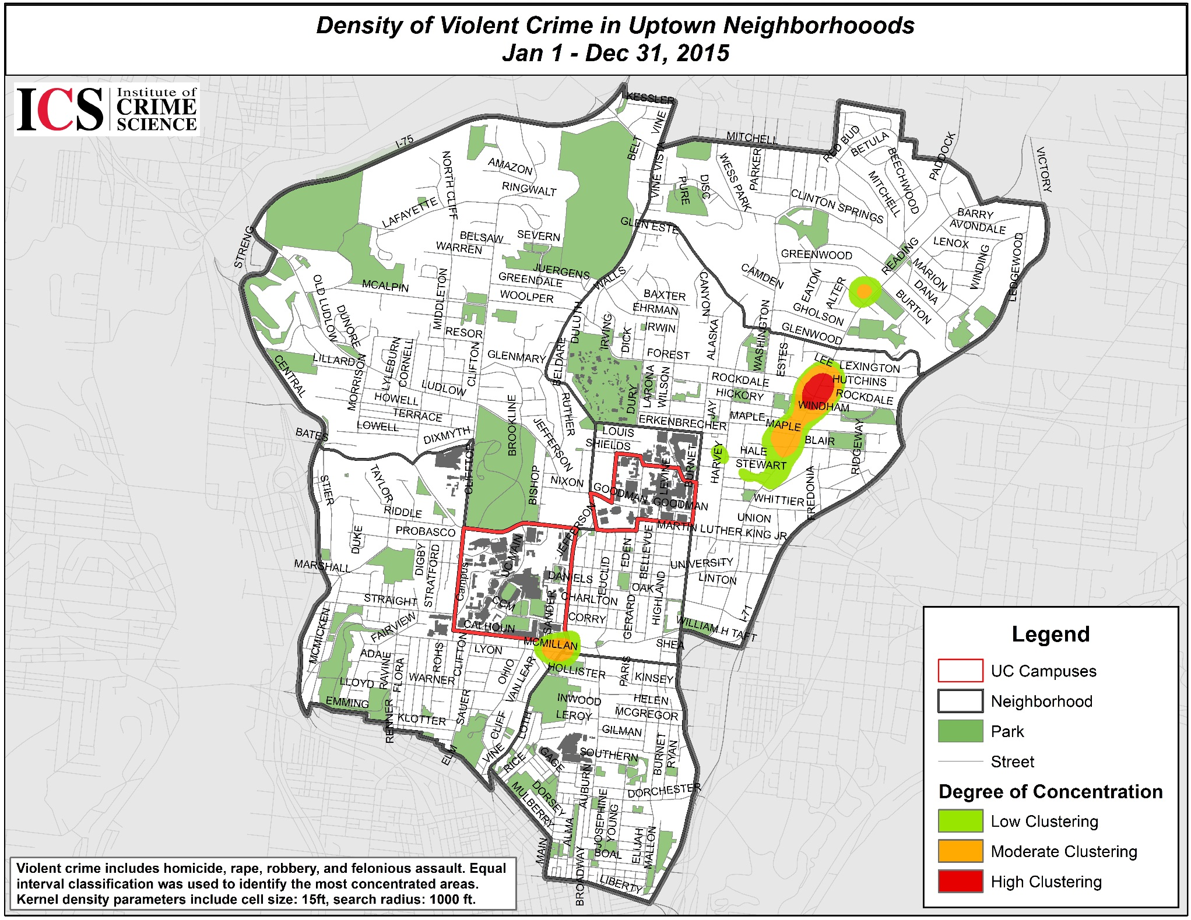
29.5% of Uptown’s Violent Crime
(⅟₂ Sq Mile area)

Slide 33
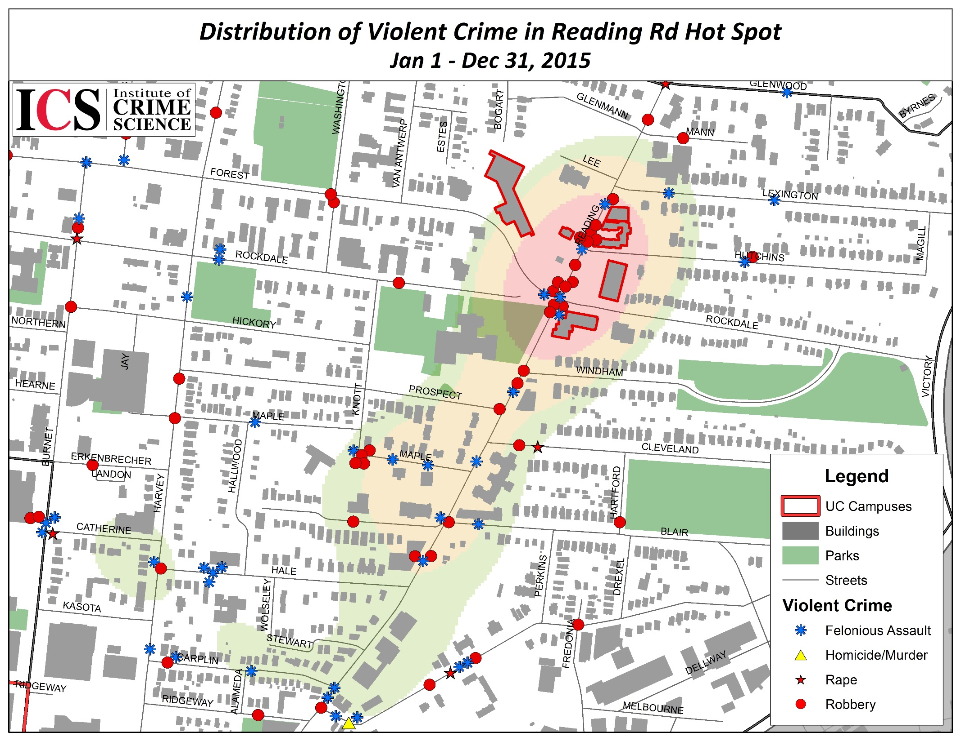
29.5% of Uptown’s Violent Crime
(⅟₂ Sq Mile area)
3520-3530 Reading Rd
601 Maple Ave
3500, 3504 Reading Rd

Slide 34
Using Data Visualization to Improve Performance
For the past several years the UC Institute for Crime Science has been working with the Cincinnati Police Division and other LE agencies to use data to improve policing
Includes advanced crime analytics, data visualization and network analysis to improve policing, use of resources, and operations and management
Uses freeware and open source programming and includes training of crime analysts for sustainability
Now beginning to work with correctional agencies

